Slide 1




PROJECT P297
HOTEL RATING CLASSIFICATION
Presented by : - Miss. Vidya c. Chavan
Guided by:- -- Karthik Muskula

Slide 2
Project Overview
This is a sample dataset that consists of 20,000 reviews and ratings for different hotels and our goal is to examine how travelers are communicating their positive and negative experiences in online platforms for staying in a specific hotel and major objective is what are the attributes that travelers are considering while selecting a hotel. With this manager can understand which elements of their hotel influence more in forming a positive review or improves hotel brand image.

Slide 3
Data set has 20,000 records with following attributes:
Details of Dataset
1
Review of Hotel
2
Rating of Hotel

Slide 4

WORKFLOW
Load Dataset
EDA
Visualizations
Text Preprocessing and Cleaning
Model Building
Model Selection
Deployment

Slide 5
EDA
Basic Analysis of dataset is done and the analysis is as follows:
Shape of the data set is 20491 rows and 3 columns.
There are no null and duplicated values in the data.
Reviews,Ratings and @ columns are given to us.
Ratings column has ratings (1,2,3,4,5) given for each review.
Words and sentences for each review is counted and add to data frame.

Slide 6
VISUALIZATIONS

Slide 7
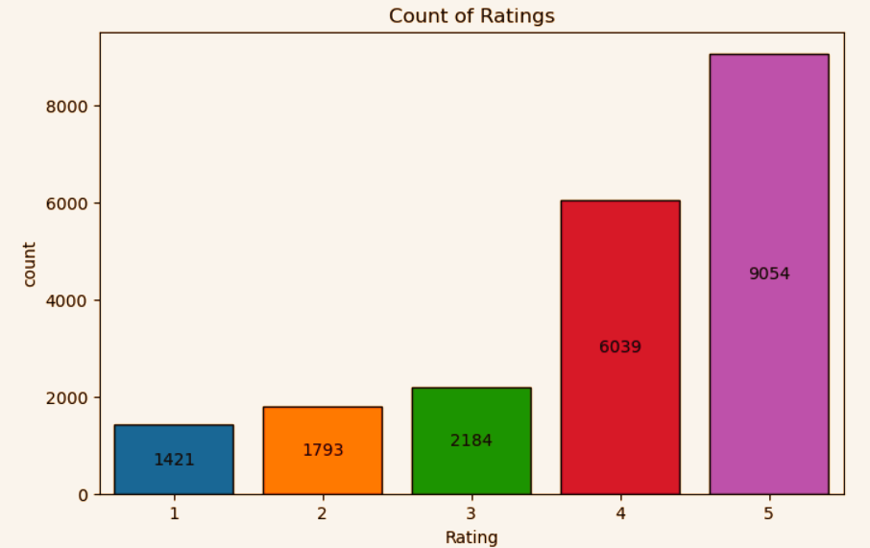
Ratings Distribution
Following is the distribution of ratings in the dataset:
1 Star Rating: 1421 Reviews
2 Star Rating : 1793 Reviews
3 Star Rating : 2184 Reviews
4 Star Rating : 6039 Reviews
5 Star Rating : 9054 Reviews
From the visualization, it is evident that maximum number of reviews have 5 star rating and then followed by 4,3,2,1.

Slide 8
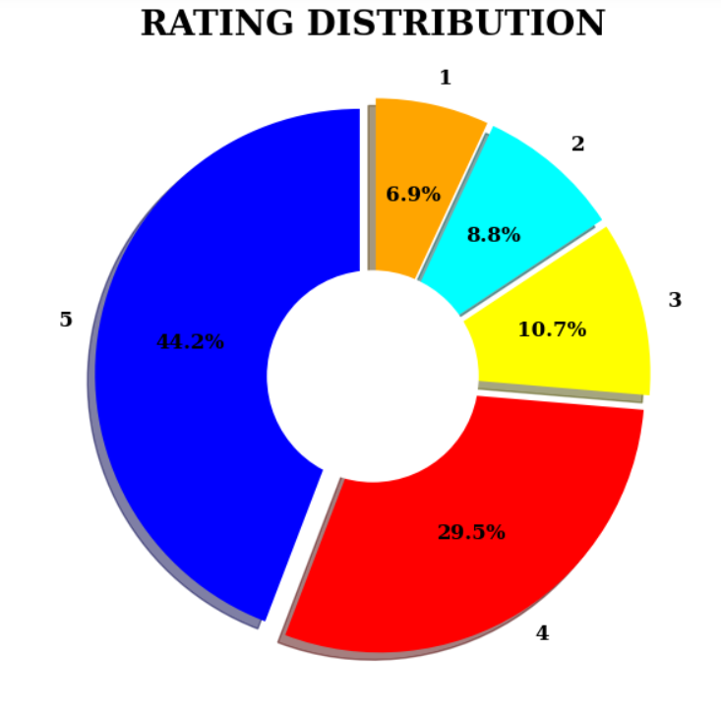
From the above visual, we can say that almost 75% of reviews are rated (5, 4) by users, and the remaining 25% of reviews are rated (3, 2, 1).
We have an unequal distribution of data, where we have less no. of negative ratings provided by users.
Hence, our dataset is highly imbalanced dataset.
% Distribution of Ratings

Slide 9
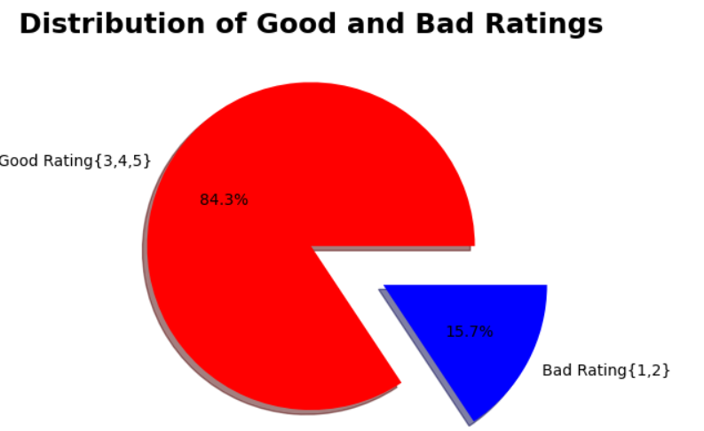
Partition of Ratings
We considered ratings 1 and 2 as ‘Bad’ and ratings 3,4,5 as ‘Good’ and plotted a pie chart.
From the chart, it is evident that 84.3% of total reviews are good reviews and 15.7% are bad reviews.

Slide 10
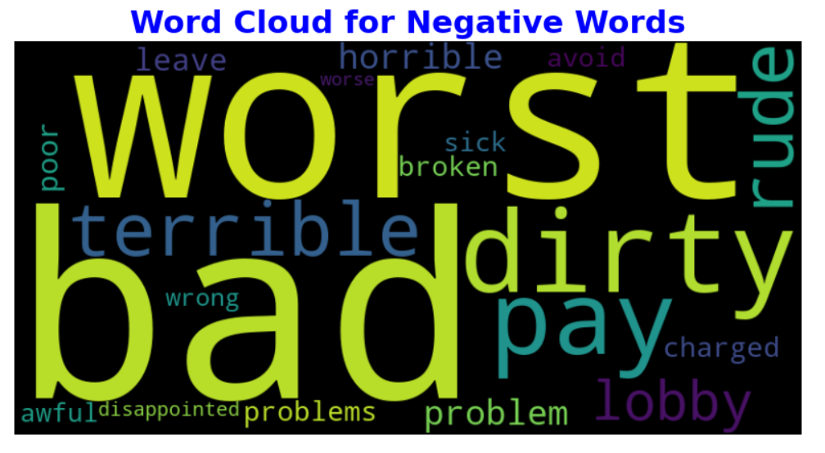
Word Cloud for Negative Words

Slide 11
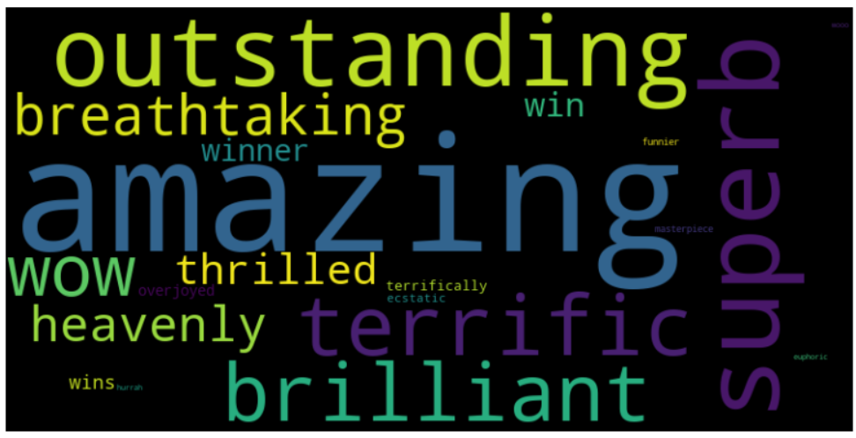
Word Cloud for Positive Words

Slide 12
SENTIME NT ANALYSIS
USING
VADER SENTIMENT ANALYZER

Slide 13
ABOUT VADER SENTIMENT ANALYSER
It takes text as input and returns
Positive Score
Negative Score
Neutral Score
Compound Score
We judge our text sentiment on the basis of compound score, if
Compound Score < -0.05 - Negative Sentiment
Compound Score > +0.05 - Positive Sentiment
Other than that neutral sentiment

Slide 14
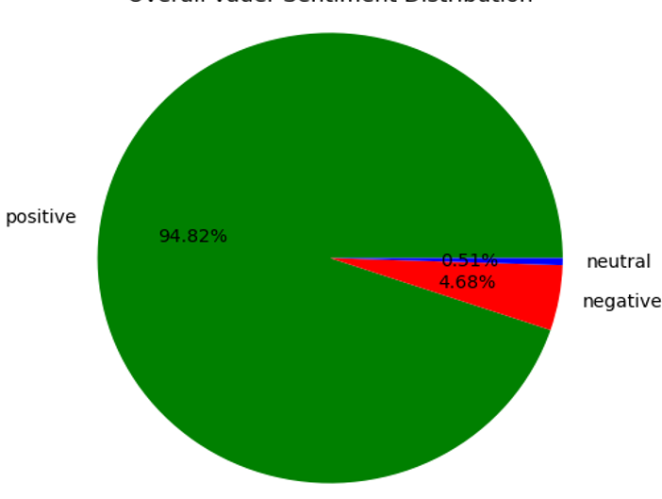
Overall Vadar Sentiment Distribution

Slide 15
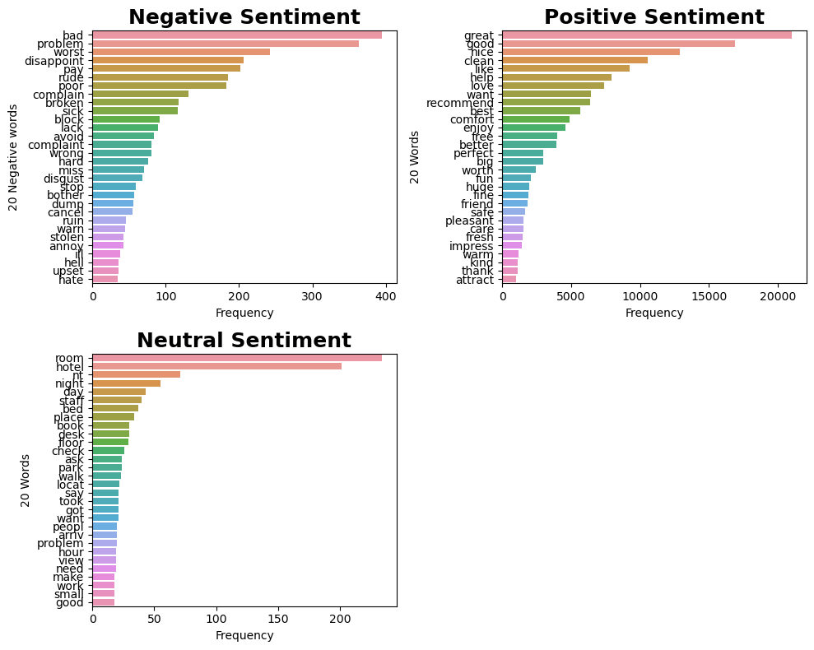
Top 20 words most frequently used in each sentiment

Slide 16
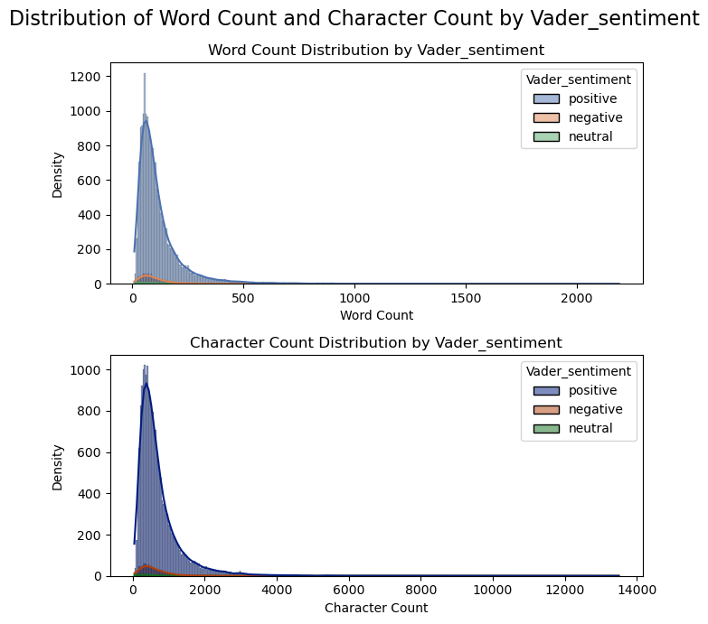
Distribution of word count and character count by Vader Sentiment Analyzer

Slide 17
SENTIMENT ANALYSIS USING
AFINN PACKAGE

Slide 18
ABOUT AFINN PACKAGE
It returns a sentiment score.
Positive Score: A positive score indicates a positive sentiment, suggesting that the text is generally positive in tone.
Negative Score: A negative score indicates a negative sentiment, suggesting that the text is generally negative in tone.
Zero Score: A zero score suggests a neutral sentiment, indicating that the text doesn’t contain a strong positive or negative sentiment.

Slide 19
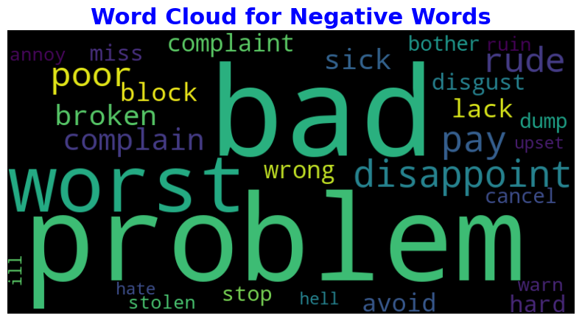
Word Cloud for Negative Words

Slide 20
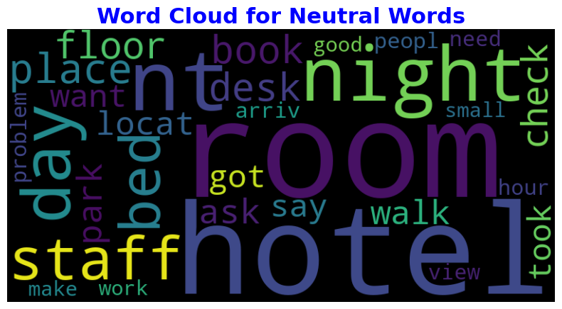
Word Cloud for Neutral Words

Slide 21
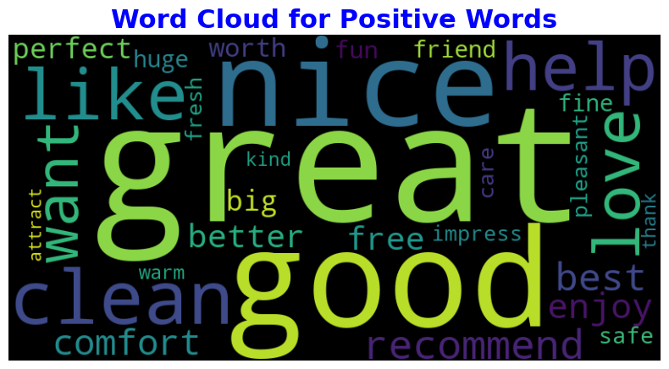
Word Cloud for Positive Words

Slide 22
IMPLEMENTATION OF Tf Idf
WE INITIALIZE OUR TFIDF WITH THE FOLLOWING PARAMETERS
STOP WORD = ‘english’
Max_features = 5000
Ngram_range = (1,3)
We get tfidf data frame with
5000 columns
20491 rows

Slide 23
MODEL BUILDING USING
TF-IDF VECTORIZER DATA
We built the following models and calculated precision scores for each model as the data is imbalanced. Precision scores for each model are as follows:
1. Logistic Model – 96.1%
2. SVM Model _ 96%
3. Naïve Bayes Model _ 92.7%
4. Decision Tree _ 86.5%
5. XG Boost Model _ 92.5%
6. LGBMlight Model _ 95.8%
Based on the above precision values we are selecting the LGBM light model for our model.

Slide 24
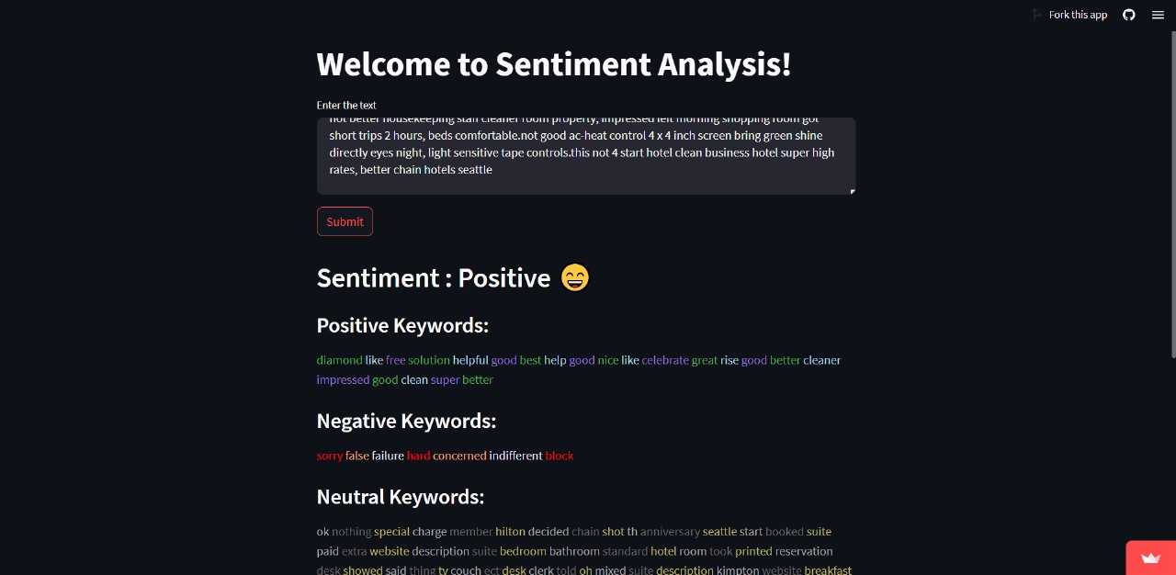
DEPLOYMENT OF MODEL
The model is deployed using streamlit.
It takes in the review as input and gives the type of rating and the top most used positive, negative and neutral keywords in the review.
app link: https://sentiment-analysis-ansari.streamlit.app/

Slide 25
CHALLENGES FACED
We faced the following challenges while executing the code:
1.Text Preprocessing: For finding the stopwards, tagging POS, removing special characters, stemming, lemitization.
2.Visualization: All the positive, negative, and neutral word clouds were displaying the same most occurring words in the beginning. So we calculated affinity scores for each type of review and created word clouds based on affinity scores.
3. Text Vectorization: We faced challenge to select number of features, selecting unigram, bigram, trigram in tfidf so, that model perform well.
4.Model Building: Models were not able to detect neutral reviews, so we had to up-sample the data and then build the models with up-sampled data to predict neutral reviews.
5.Deployment: Deploying an NLP model was quite difficult for us. We have gone through many documents regarding NLP deployment and then deployed the model.

Slide 26
CONCLUSION
The data consists of 20,000 reviews of all hotels along with their ratings.
We built various models to assess the rating of each review and finalized LGBM light model.
Model is deployed using streamlit which takes the review and tells us whether the review is positive, negative, or neutral.
It also displays the words corresponding to the rating.
Based on this result any hotel can check the sentiment of the review and the top-most words used in the review, which in turn helps them to improve their service further.

Slide 27
THANK YOU

